Slide 1

Dependency inversion

Slide 2
Dive into the popular design pattern
In traditional software architecture we design lower level components to be used/consumed by higher level components. In other words, higher level components depend on lower level components. This dependency causes tight coupling in the software. As explained in principle one, we strive to achieve loose coupling to make it easier to develop, maintain and change code in the future.
The dependency inversion principle inverts this dependency in the sense that instead of higher level components depending on lower level ones, both should depend on abstractions. This abstraction layer would be an intermediate component that sits between the higher and lower level components. The two will then use this component to communicate and interact amongst each other. The abstraction component would usually be implemented as an interface.
Notes:
This is a straightforward solution for calculating the average of 2 numbers.
Notice the code in lines 3-5, repeated in lines 7-9.

Slide 3
Consider the following example where we model a robot:
The Robot class has only one function get_energy.
We model an Apple that the robot can get energy from.
Now, at some point the robot will get tired of eating apples.
So we add a Chocolate class to offer more eating options to the robot.
class Apple: def eat(self): print(f"Eating Apple. Transferring {5} units of energy to brain...") class Robot: def get_energy(self): apple = Apple() apple.eat() if __name__ == '__main__': robot = Robot() robot.get_energy()
class Apple: def eat(self): print(f"Eating Apple. Transferring {5} units of energy to brain...") class Robot: def get_energy(self): apple = Apple() apple.eat() if __name__ == '__main__': robot = Robot() robot.get_energy()
Notes:
This is a straight forward solution for calculating the average of 10 numbers.
Notice now the code in lines 4-6 repeated more than once (3 times to be exact).
In real life, the size of data that programs deal with, is generally huge.
For example:
Bank system calculations
Seeking information on the web.
Image processing
Network traffic monitoring
etc…
It would be impractical to repeat the same few commands dozens, or hundreds or thousands of times.
Programs would become unreadable, error-prone and hard to fix.
There must be another solution for the repetition-of-similar-or-same-code problem!

Slide 4
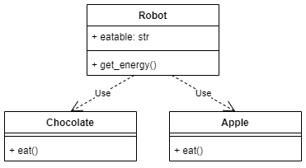
Notice however, what happens to the get_energy method. We must pass a string as a parameter indicating what eatable the robot should eat. Also, we must use if-else branching on the two different eatables. Now you can imagine if more eatables are added we would need more else branches. This is not good design.
Furthermore, because Robot has a dependency on each of the individual eatables we will run into issues if the implementation of one of the eatables changes. For example, if we introduce an additional parameter to the eat method in Chocolate the code in get_energy would break and we would have to refactor it to reflect the changes in Chocolate. These issues occur due to tight coupling and strong dependencies and are a violation of the dependency inversion principle.

Slide 5
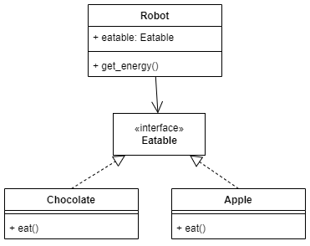
Solution
To solve this, we need to introduce an abstraction layer. We modify the architecture as follows:
The code looks like so:
from abc import ABC, abstractmethod class Eatable(ABC): @abstractmethod def eat(self): return NotImplemented class Apple(Eatable): def eat(self): print(f"Eating Apple. Transferring {5} units of energy to brain...") class Chocolate(Eatable): def eat(self): print(f"Eating Chocolate. Transferring {10} units of energy to brain...") class Robot: def get_energy(self, eatable: Eatable): eatable.eat() if __name__ == '__main__': robot = Robot() robot.get_energy(Apple())
Notes:
A loop is a mechanism for defining the repetition of a code segment.
Each repetition is called an Iteration.
In this chapter we will learn about the following loop types:
The while loop
The for loop
These are not the only loop types in Python, but they are very common in most programming languages.

Slide 6
We create an Eatable interface that is implemented by both Apple and Chocolate.
We change the method signature of get_energy so that it expects an argument of type Eatable instead of str. This means we can get rid of the if-else branching. Furthermore, since all eatables implement the Eatable interface we are sure that there will be no code breakage if there changes to Chocolate or Apple.
Notes:
The while keyword indicates the use of the while loop.
A condition is checked.
If the condition evaluates to true, a block of commands (enclosed in braces) is executed.
When the program is done executing the block, the condition is checked again.
The block will be executed again and again, as long as the condition
evaluates to true.
As soon as the condition turns to false the block is skipped.

Slide 7
Conclusion
In this post, we looked at the dependency inversion principle. The principle essentially states that higher level modules should not depend on lower level modules. Instead both should depend on abstractions. We make higher level modules independent of implementation specifics in lower level modules.
The principle:
Enforce loose coupling and thereby helps make code more robust in face of changes.
Allows re-use of higher level components since the abstraction layer prevents code breakage in case the lower level components need to be changed.
We have finally reached the end!
Notes:
Syntax
while 'condition': //colons at the end of the line to determine the beginning of the loop scope
one or more commands //in a slight indentation to the right
…
The slight indentation to the right defines all the commands meant for repetition into a
repeating block called the loop block (also known as loop body).
Action
The loop continues to iterate as long as the value of the condition is true.
The condition is re-evaluated before each repetition of the loop block.
In this case the condition is (number < 1000) and the loop block is in lines 3-4.
Important
Consider a loop in action.
What makes it stop?
If the program is executing the code in the loop, will it do so “forever”?
For the program to eventually exit the loop the condition must be false at some point.

Slide 8
Additional information
Cohesion and coupling: write BETTER PYTHON CODE Part 1
https://www.youtube.com/watch?v=Kv5jhbSkqLE
Cohesion & Coupling in Python
An Explanation of the Two Important Quality Metrics in OOP
https://haseebkamal.com/the-dependency-inversion-principle-explained-in-python/
Notes:
Notice that
the loop block (lines 3-5) contains only program-related commands and no loop-related command. This way, we won’t accidentally omit to increment the counter or perform any other loop-related statements.
"i" is initialized in the loop header (line 2). Therefore it does not need to be initialized in a declaration.
In that case, i will be unrecognized when used outside the loop
(compile-time error).
Q: Why does result need to initialized upon declaration (line 6)?

